Slide 1

Note: The data and information in this document is reflective of a hypothetical situation and client. This document is to be used for KPMG Virtual Internship purposes only.
Sprocket Central Pty Ltd
Data analytics approach
[Division Name] - [Engagement Manager], [Senior Consultant], [Junior Consultant]

Slide 2
Note: The data and information in this document is reflective of a hypothetical situation and client. This document is to be used for KPMG Virtual Internship purposes only.
Agenda
Introduction
Data Exploration
Model Development
Interpretation

Slide 3
Note: The data and information in this document is reflective of a hypothetical situation and client. This document is to be used for KPMG Virtual Internship purposes only.
Introduction
Problem Statement and Solution:
Approach:
Comparing bike purchases for the past 3 year based on gender.
Analyzing the wealth segment.
Analyzing the online orders with gender.
Evaluation of sum of value by wealth segment.
Analyzing the purchases done by the people based on states.
Comparing the job industry with the purchases for the past 3 years.
Sprocket Central is a company that specializes in high-quality bikes and cycling accessories is looking to boost business sales by analyzing provided datasets.
4 datasets were provided the aim is to analyze and explain the insights of the provided datasets and solution to improve the sales value.

Slide 4
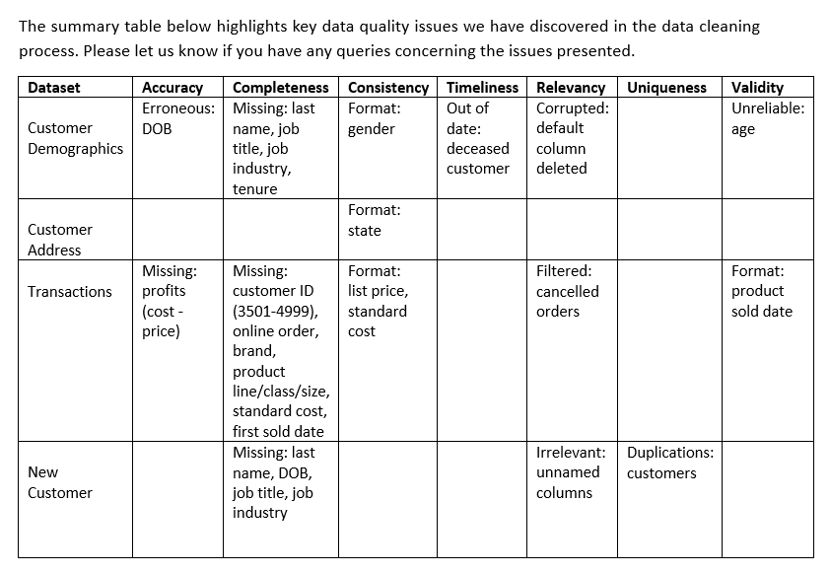
Note: The data and information in this document is reflective of a hypothetical situation and client. This document is to be used for KPMG Virtual Internship purposes only.
Data Exploration
Data Preprocessing works carried out for the four datasets:
I have evaluated the datasets according to the data quality dimensions framework as follows:
Accuracy – correct values
Completeness – data fields with values
Consistency – values free from contradiction
Timeliness – values up to date
Relevancy – data item with value meta-data
Uniqueness – records that are not duplicated
Validity – data containing allowable values
Place any supporting images, graphs, data or extra text here.

Slide 5
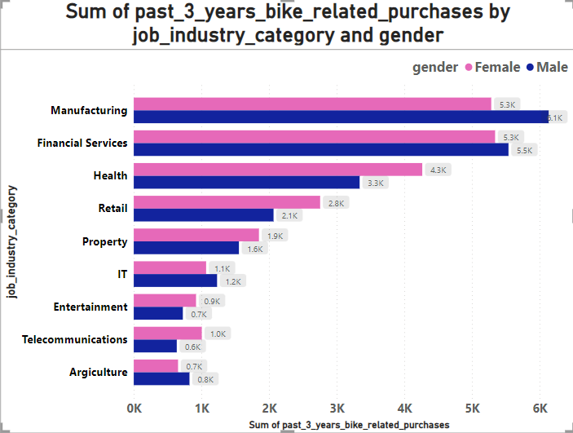
Note: The data and information in this document is reflective of a hypothetical situation and client. This document is to be used for KPMG Virtual Internship purposes only.
Data Exploration
Purchase details based on gender and job industry category:
The picture shows the details of the past 3 years bike related purchase by job industry and category and gender.
* It is clear that the female has the highest purchases when compared to the male in overall and in the case of manufacturing and financial services male has the highest purchases.
Place any supporting images, graphs, data or extra text here.

Slide 6
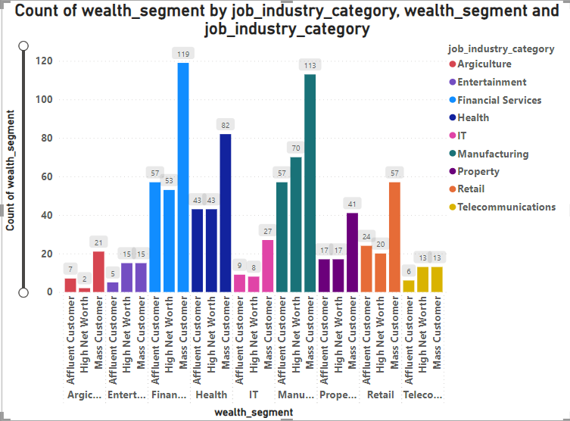
Note: The data and information in this document is reflective of a hypothetical situation and client. This document is to be used for KPMG Virtual Internship purposes only.
Data Exploration
Count of wealth segment by job industry:
The visual clearly explain the details of the count of wealth segment by job industry.
* From the Financial services the mass customers has the highest count of wealth segment.
Place any supporting images, graphs, data or extra text here.

Slide 7
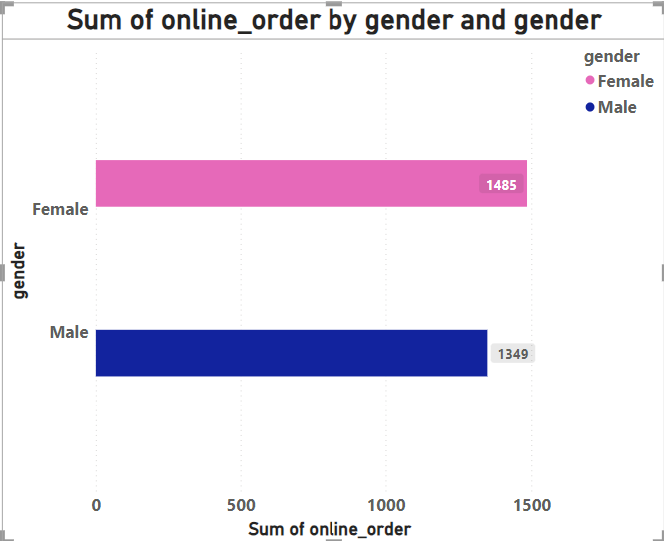
Note: The data and information in this document is reflective of a hypothetical situation and client. This document is to be used for KPMG Virtual Internship purposes only.
Data Exploration
Total sum of online order based on gender:
Here it is clear that the female has made more number of online orders when compared to the male.
Female had made 1485 online orders, whereas male has made only 1349 online orders.
Place any supporting images, graphs, data or extra text here.

Slide 8
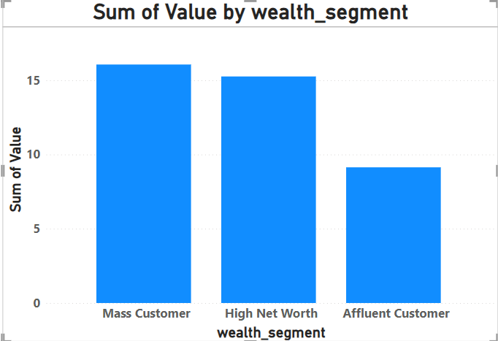
Note: The data and information in this document is reflective of a hypothetical situation and client. This document is to be used for KPMG Virtual Internship purposes only.
Data Exploration
Total sum of value by wealth segment:
From the image it is clear that Mass Customers has the highest sum of value by wealth. The mass customers play a major role in the purchase and it is impacting the sales revenue.
Place any supporting images, graphs, data or extra text here.

Slide 9
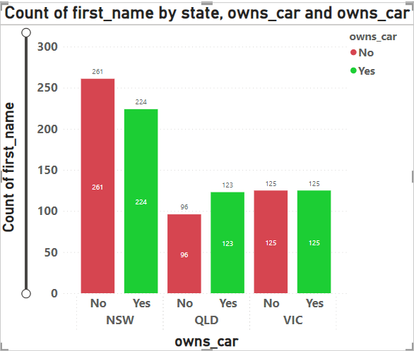
Note: The data and information in this document is reflective of a hypothetical situation and client. This document is to be used for KPMG Virtual Internship purposes only.
Data Exploration
Customers who owns more cars:
Here, we are comparing the states of customers who owns a more number of cars.
* NSW state customers has owned more number of cars when compared to the other states.
Place any supporting images, graphs, data or extra text here.

Slide 10
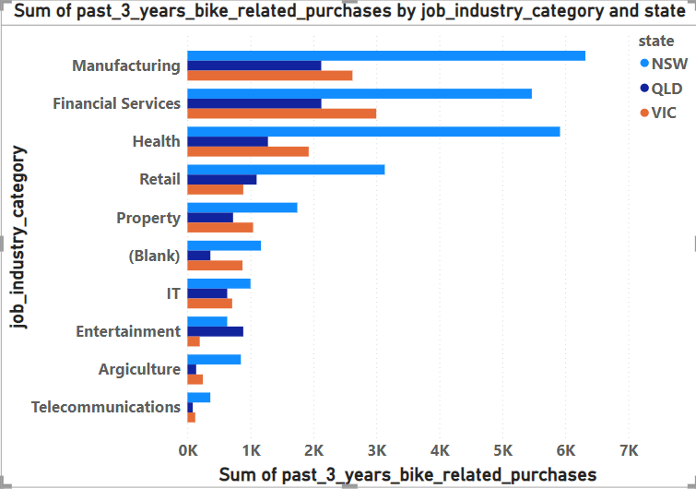
Note: The data and information in this document is reflective of a hypothetical situation and client. This document is to be used for KPMG Virtual Internship purposes only.
Data Exploration
Sum of purchases made by the state based on their job industry:
From the image we can conclude that NSW state has made the highest purchase when compared to the other two states.
In this manufacturing, financial services and health sectors have made the more purchase.
Place any supporting images, graphs, data or extra text here.

Slide 11
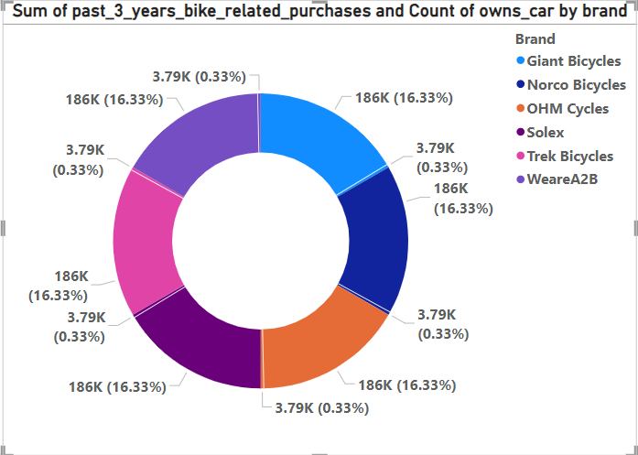
Note: The data and information in this document is reflective of a hypothetical situation and client. This document is to be used for KPMG Virtual Internship purposes only.
Data Exploration
Visualizing the brands and their sales:
Here the brands and their sales details were visualized.
We can see that the sales percentage of the brands and their sales value.
Place any supporting images, graphs, data or extra text here.

Slide 12
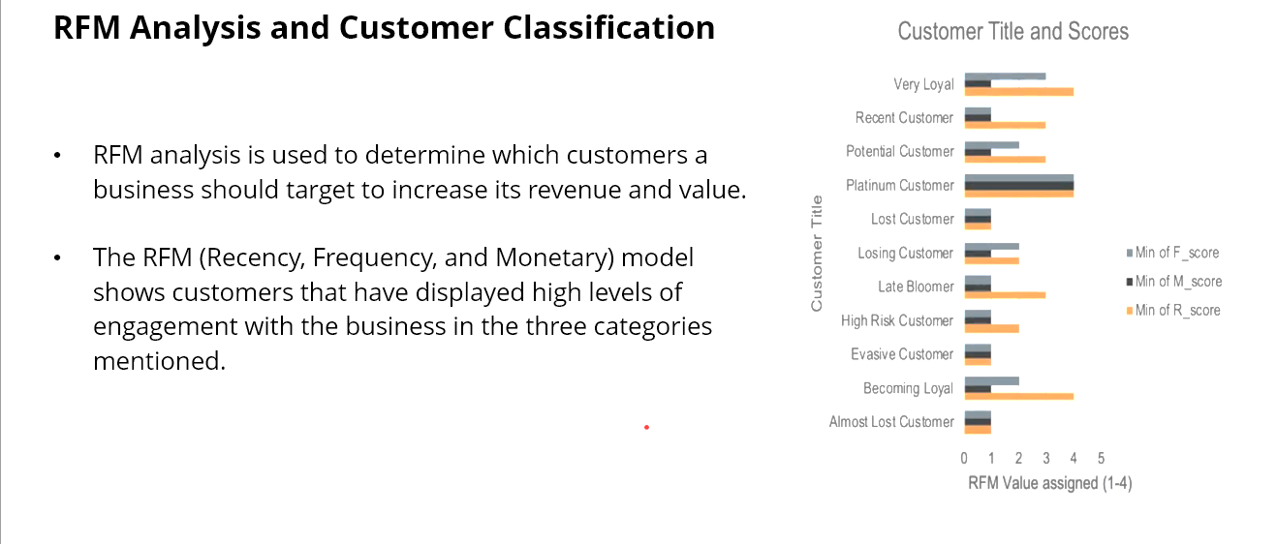
Note: The data and information in this document is reflective of a hypothetical situation and client. This document is to be used for KPMG Virtual Internship purposes only.
Model Development
Place any information about this point here.
Place any supporting images, graphs, data or extra text here.

Slide 13
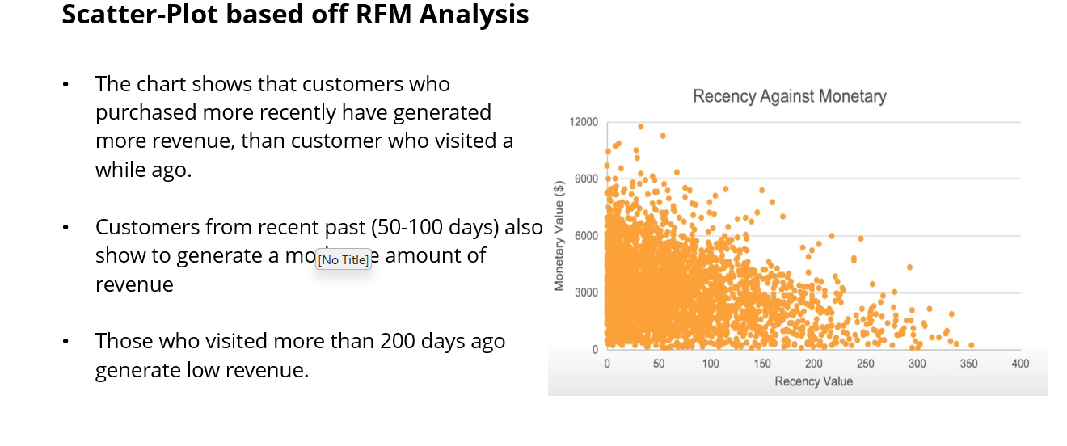
Note: The data and information in this document is reflective of a hypothetical situation and client. This document is to be used for KPMG Virtual Internship purposes only.
Model Development:
Place any information about this point here.
Place any supporting images, graphs, data or extra text here.

Slide 14
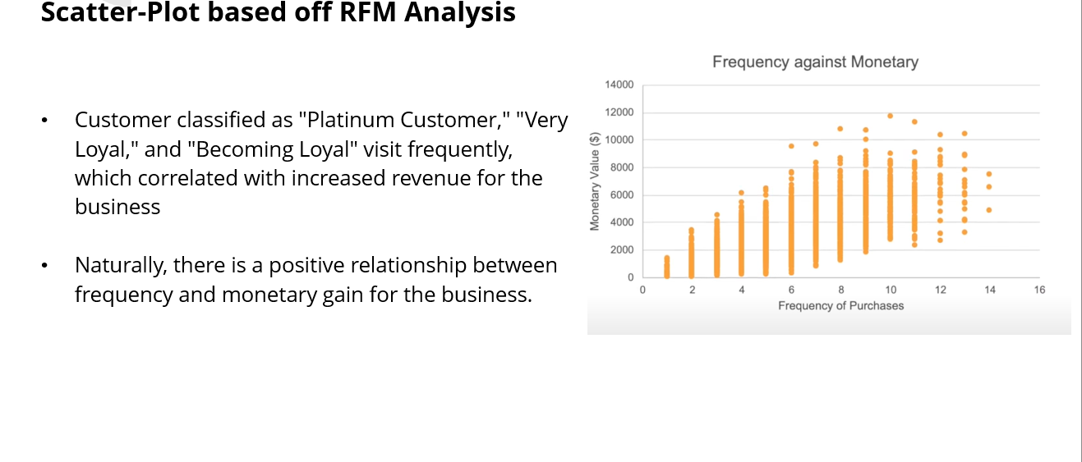
Note: The data and information in this document is reflective of a hypothetical situation and client. This document is to be used for KPMG Virtual Internship purposes only.
Model Development:
Place any information about this point here.
Place any supporting images, graphs, data or extra text here.

Slide 15
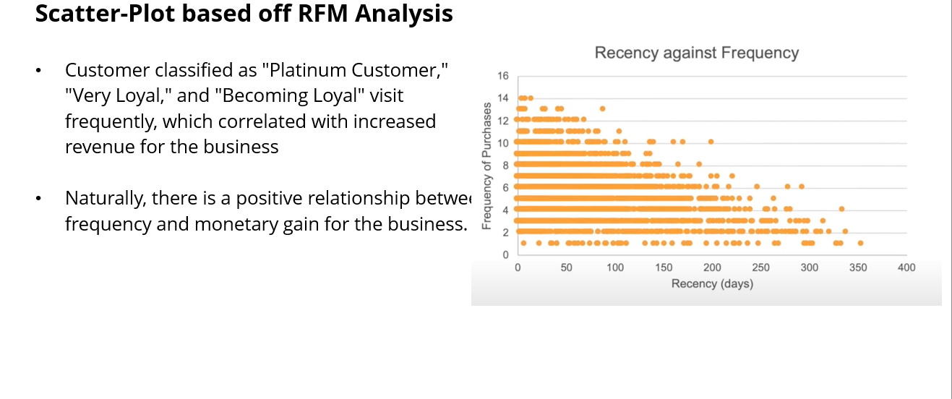
Note: The data and information in this document is reflective of a hypothetical situation and client. This document is to be used for KPMG Virtual Internship purposes only.
Model Development:
Place any information about this point here.
Place any supporting images, graphs, data or extra text here.

Slide 16
Note: The data and information in this document is reflective of a hypothetical situation and client. This document is to be used for KPMG Virtual Internship purposes only.
Interpretation
Customer Segmentation – Targeting High Value Customers.
The following things to be considered to improve the business revenue:
The female customers should be targeted because of their highest online purchases.
The customers who are living in the NSW and VIC states have owned more cars and they have highest values when we visualized their wealth segment. So they should be considered as high value customers and they can be targeted.
The people who are working in the Manufacturing, Health and Services have made a impact on the past 3 year purchase sales and they can make a impact on the future sales revenue also.

Slide 17
Note: The data and information in this document is reflective of a hypothetical situation and client. This document is to be used for KPMG Virtual Internship purposes only.
Thank you..!

